Slide 1
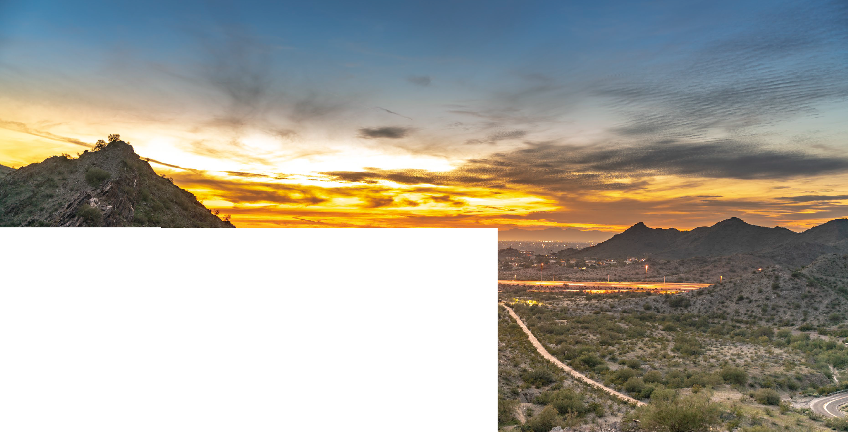
General Plan Update: 2025

Slide 2
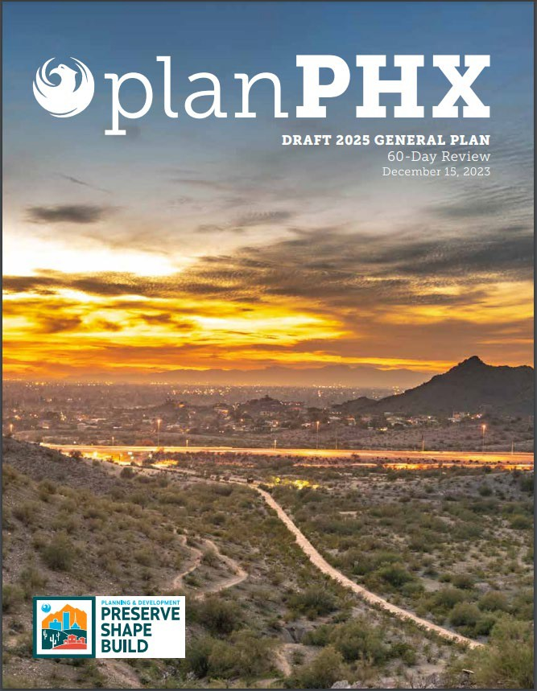
Our model is a strategic outline for growth and engagement.
General Plan Update - 2025

Slide 3
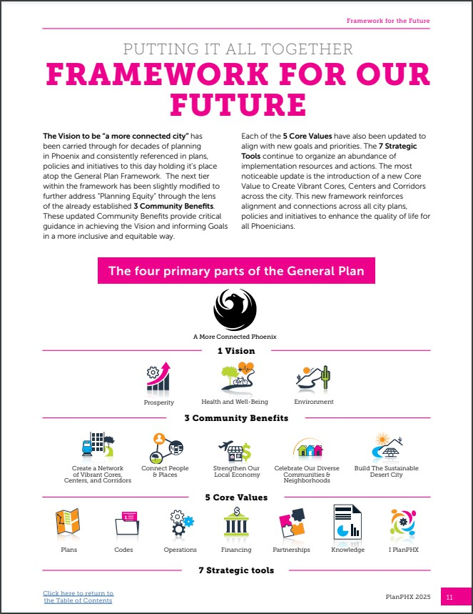
Beginning in 2015, we have changed planning conversations to be much more transparent and intentional.
General Plan Update - 2025

Slide 4
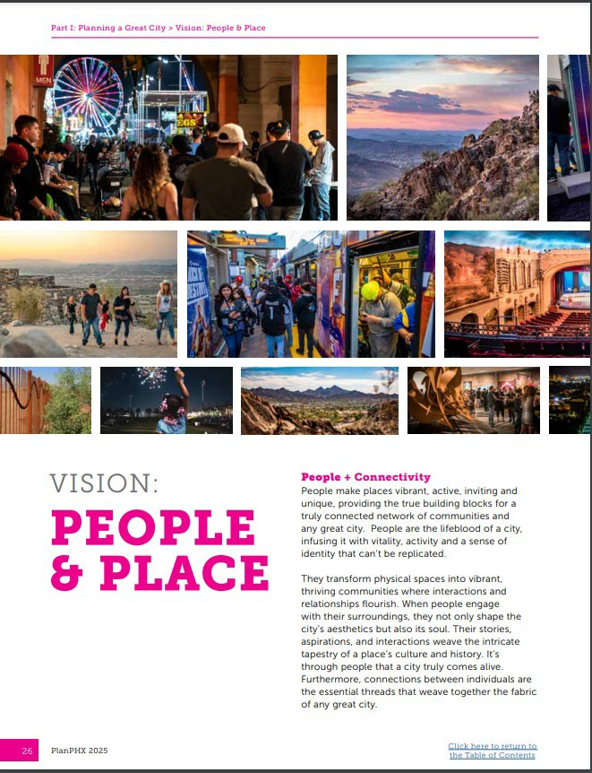
Planning in Phoenix is not isolated but works together in a symphony of community voices and stories.
General Plan Update - 2025

Slide 5
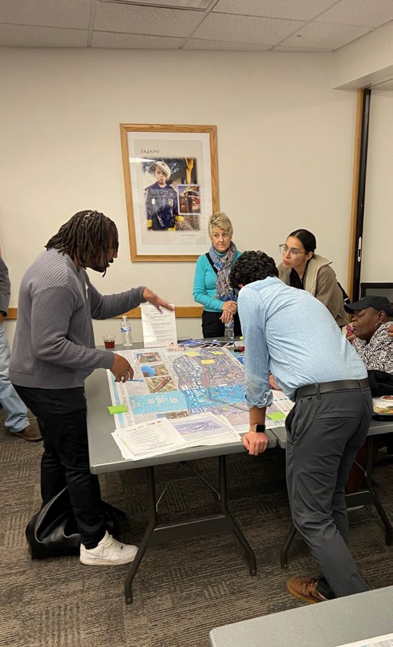
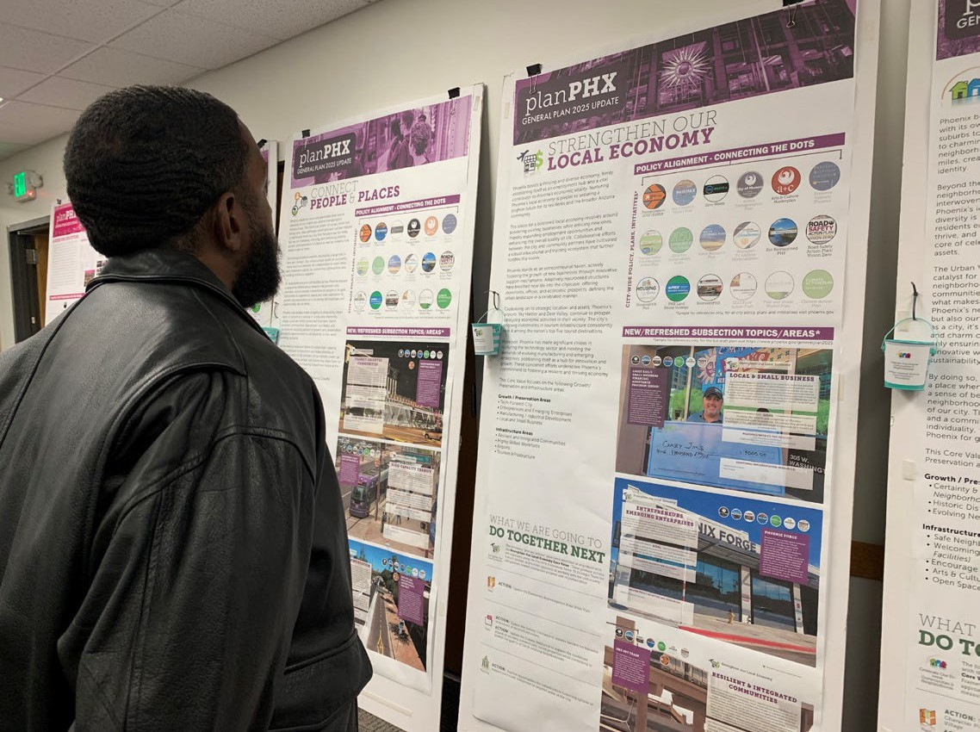
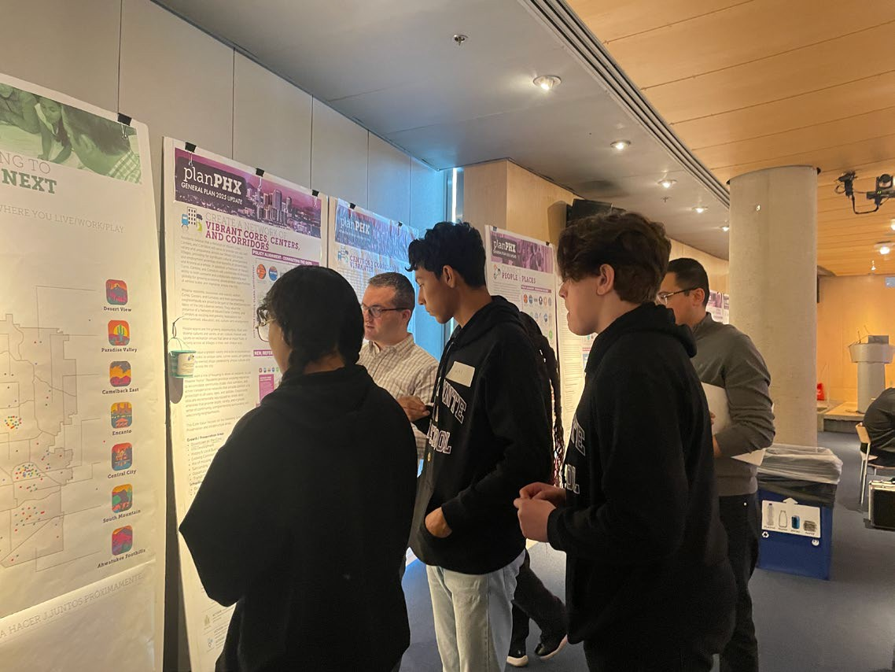
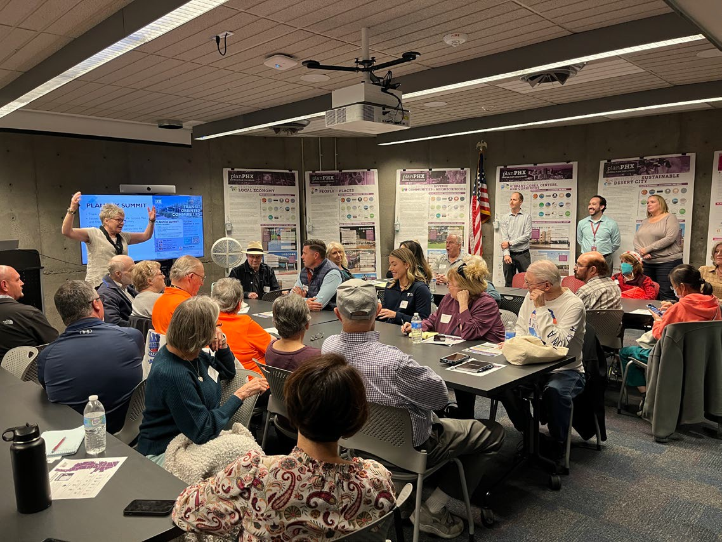
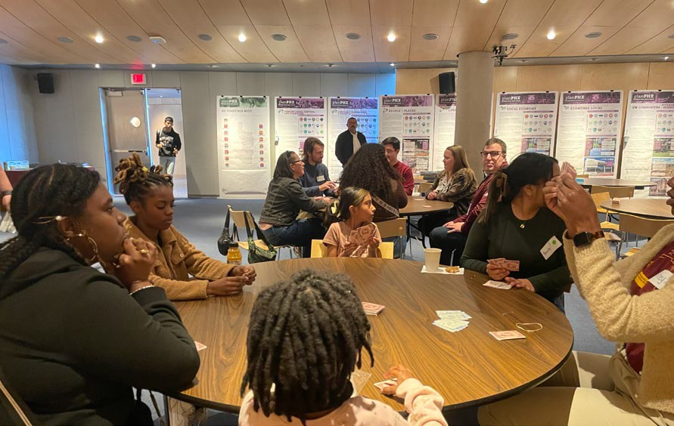
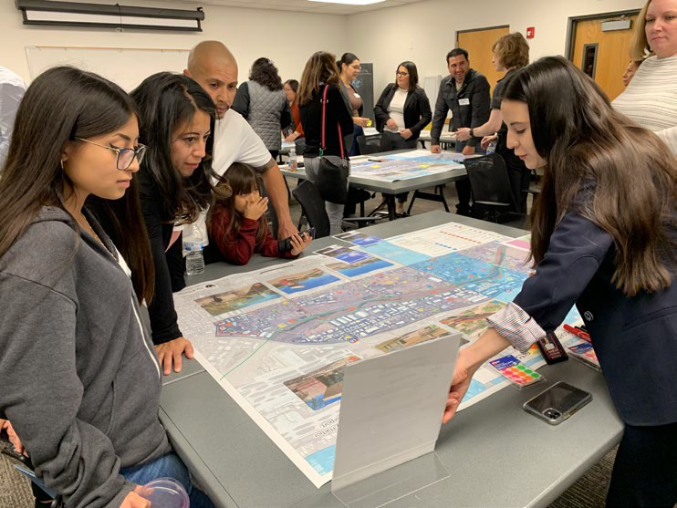
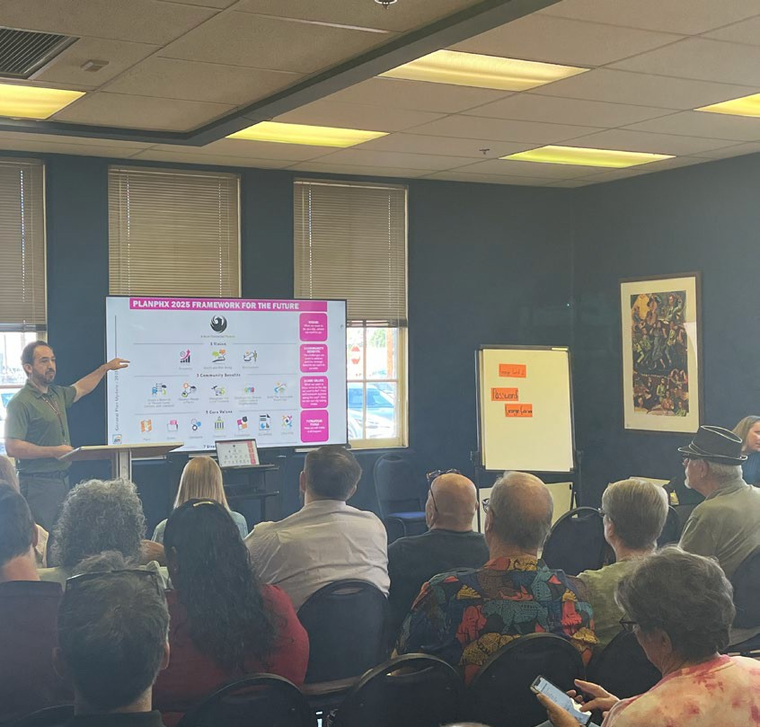
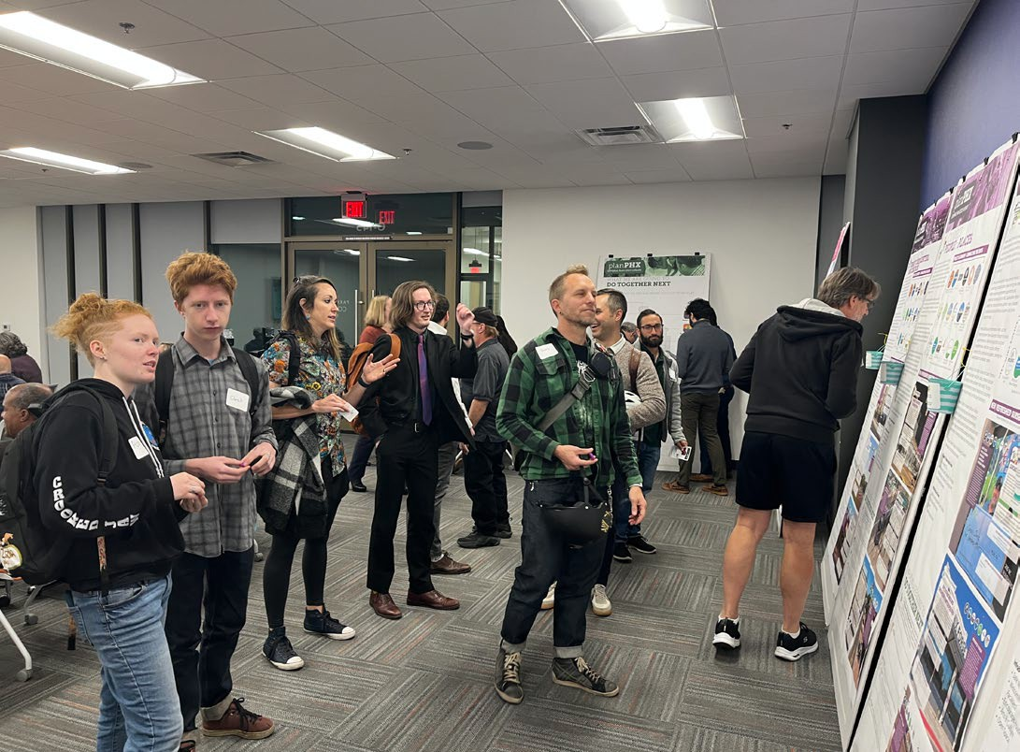
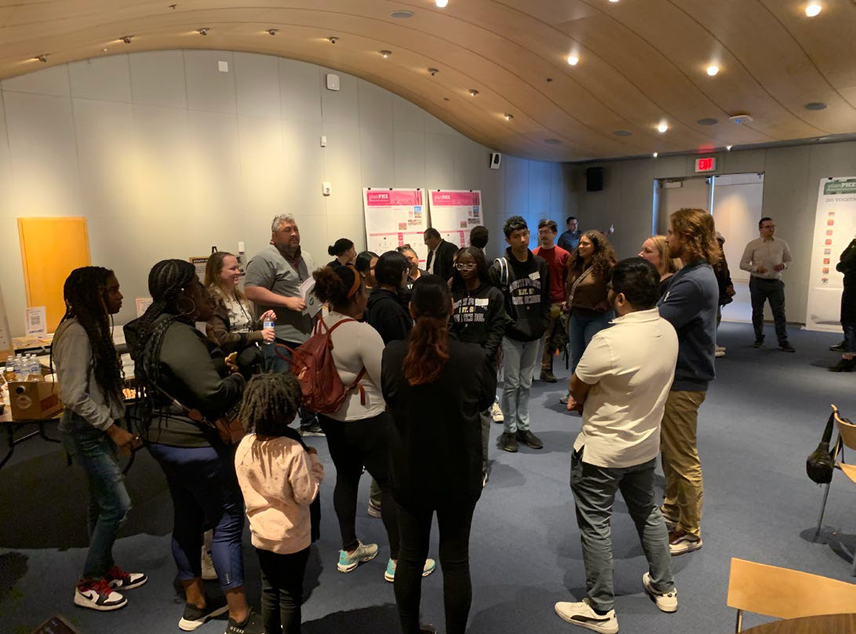
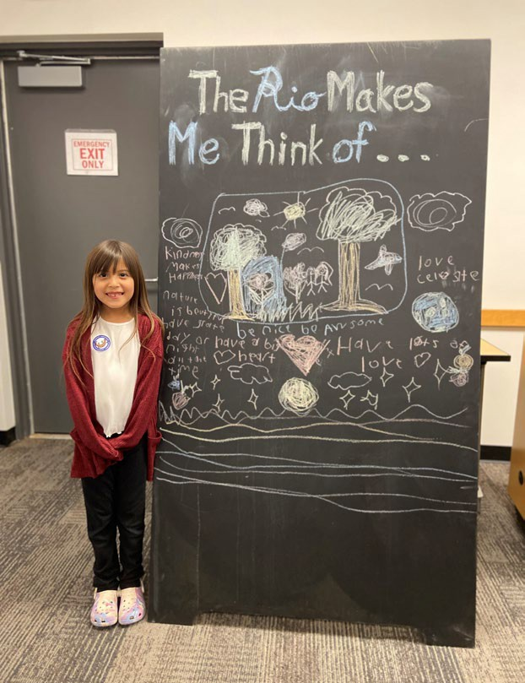
Our plan endeavors to assure all opinions find direction.
General Plan Update - 2025

Slide 6
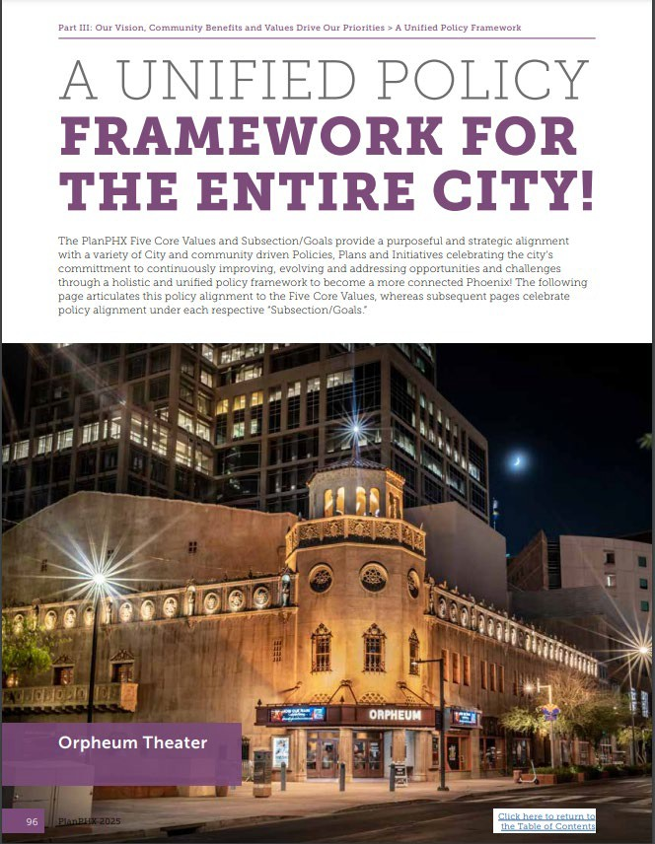
PlanPHX aligns the framework for important planning conversations to occur by establishing guidelines for success and innovations, not simply limits or boundaries.
General Plan Update - 2025

Slide 7
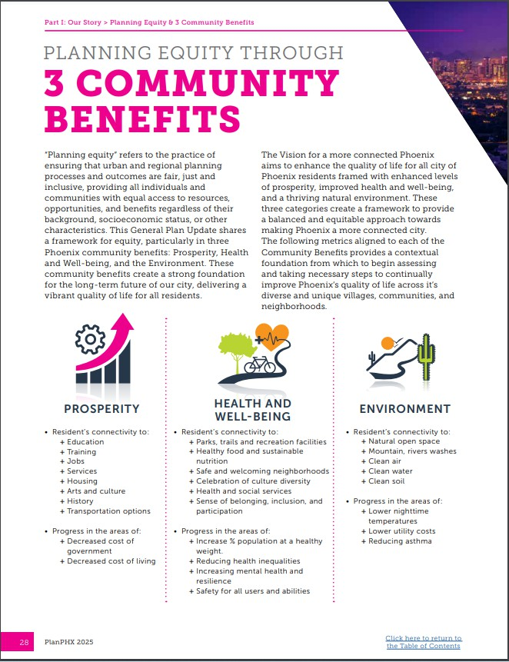
Understanding what equity means, why it matters, and intentionally focusing on it in planning, is critical to equitable outcomes.
General Plan Update - 2025

Slide 8
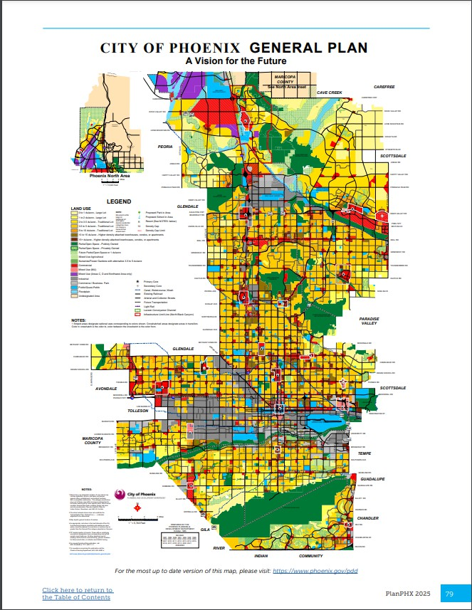
The Land Use Map is referenced by the General Plan, with a separate process to update or revise.
General Plan Update - 2025

Slide 9
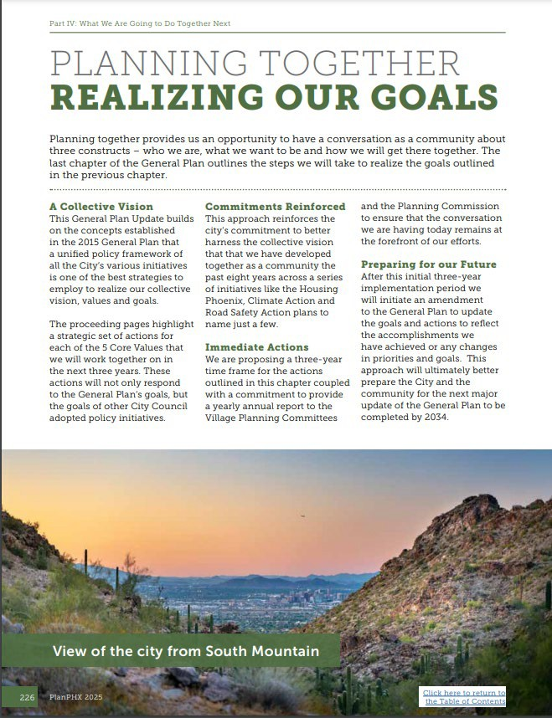
This is a living model that is meant to be reviewed, maintained and communicated with annual reports.
General Plan Update - 2025

Slide 10
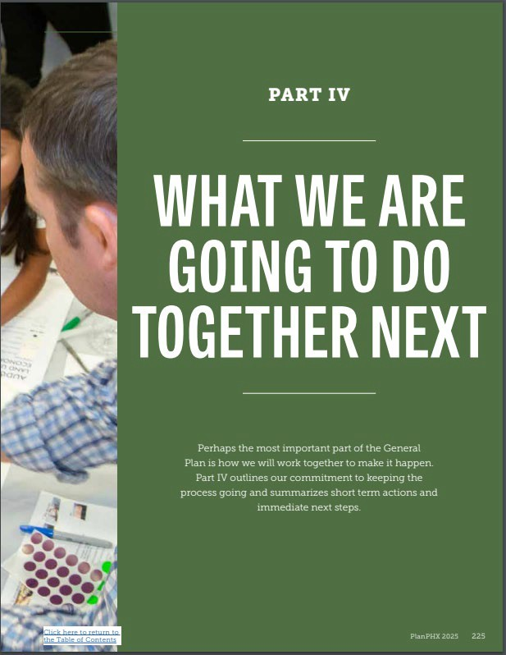
Adoption
To be adopted, the General Plan requires a public vote.
Vote Yes! Proposition 488
Vote by mail begins October 9, 2024
Election Day: November 5, 2024
General Plan Update - 2025

